Slide 1
Machine Learning
Heart Attack Prediction
Thu Vu, Ariel Wang

Slide 2
INTRODUCTION
Dataset:
Heart Attack Analysis & Prediction Dataset
From Kaggle
Unsupervised Analysis:
K-means
Supervised Analysis:
Logistic Regression
Support Vector Machine (SVM)
Artificial Neural Network

Slide 3
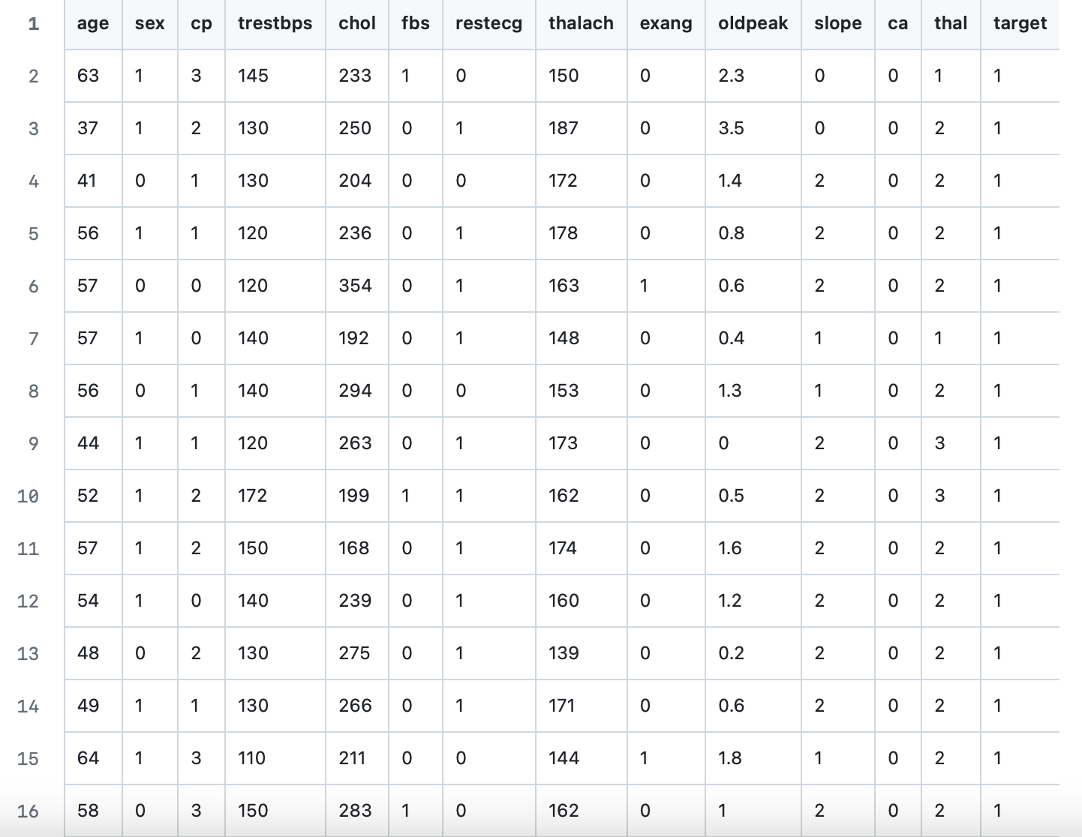
Data
This database contains 14 attributes
The "target" field refers to the presence of heart disease in the patient. It is integer valued 0 = no/less chance of heart attack and 1 = more chance of heart attack
→ Binary classification
Features including: age, sex, chest pain type (4 values from 0-3), resting blood pressure, serum cholesterol (mg/dl), fasting blood sugar (if > 120 mg/dl), etc.

Slide 4
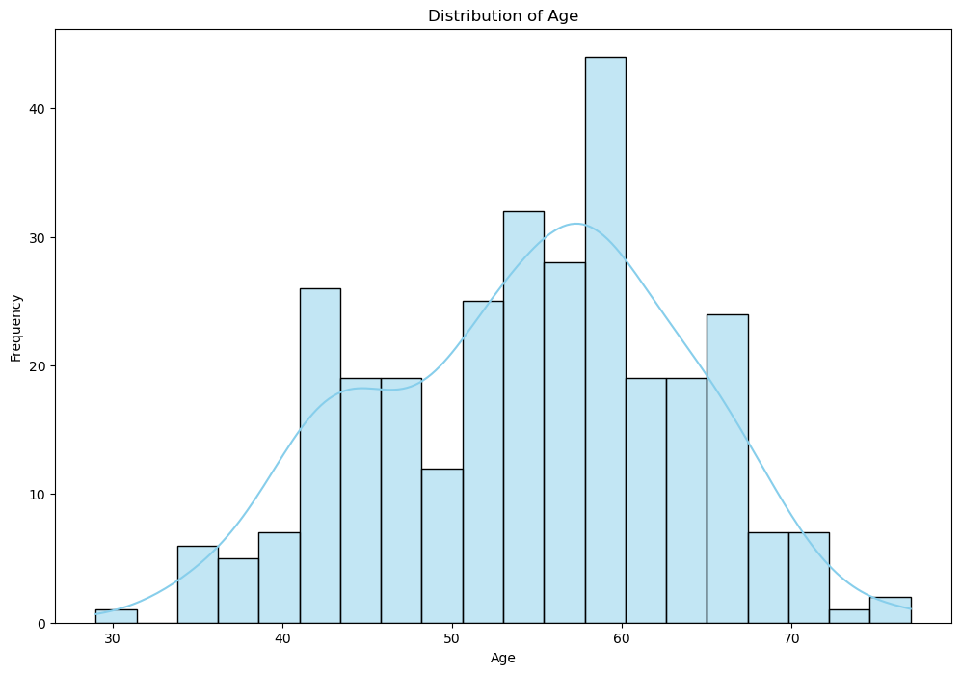
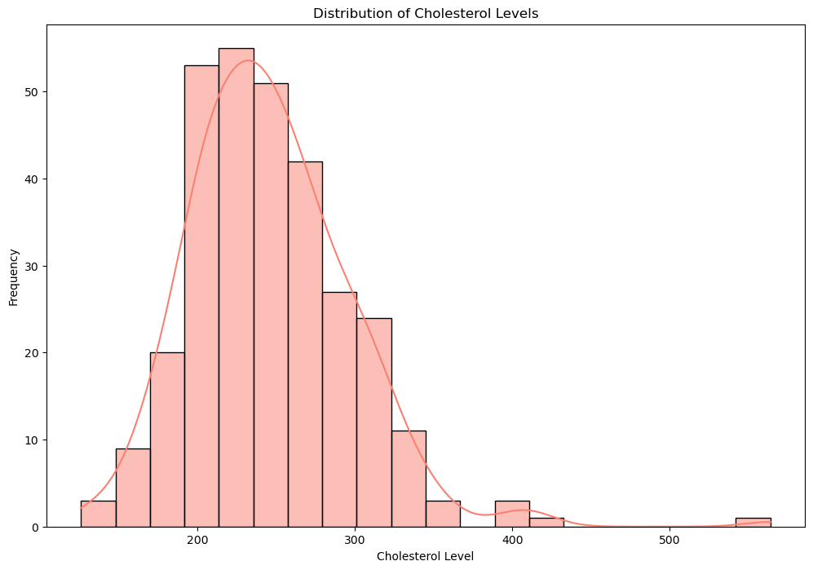
Unsupervised Analysis
Plot histograms for numerical features

Slide 5
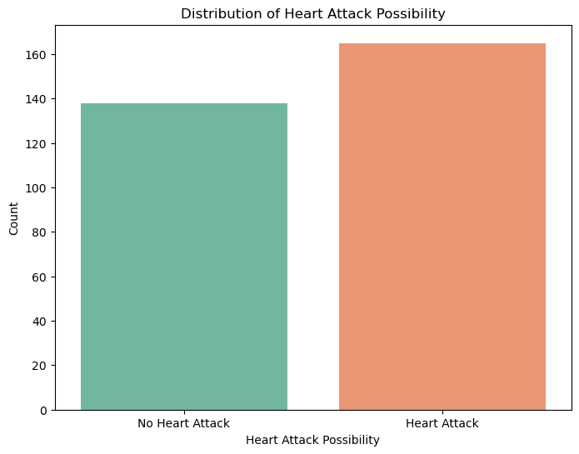
Unsupervised Analysis
Plot bar plot for target variable
→ A pretty even distribution of positive and negative target values

Slide 6
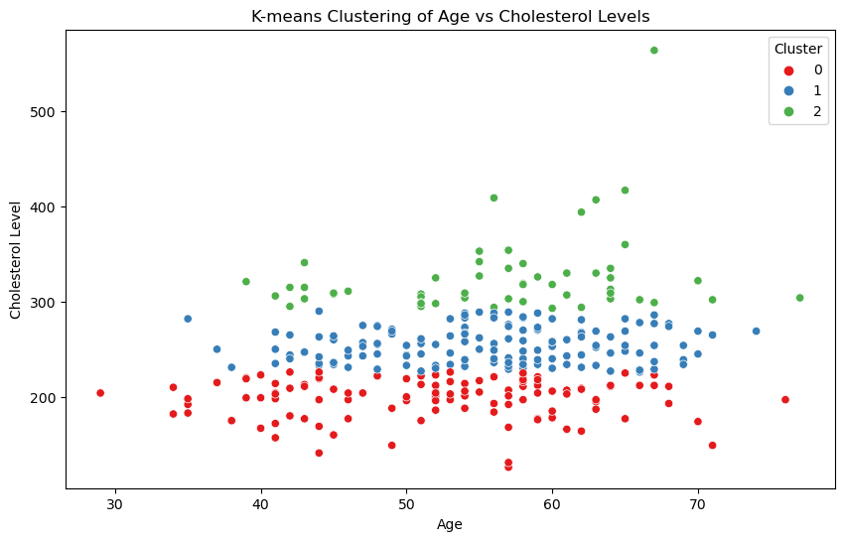
Unsupervised Analysis: K-Means Clustering
Clusters seem to be aligned horizontally
DATA UNSCALED!!
Cholesterol levels are in the hundreds while age is only from 30-70

Slide 7
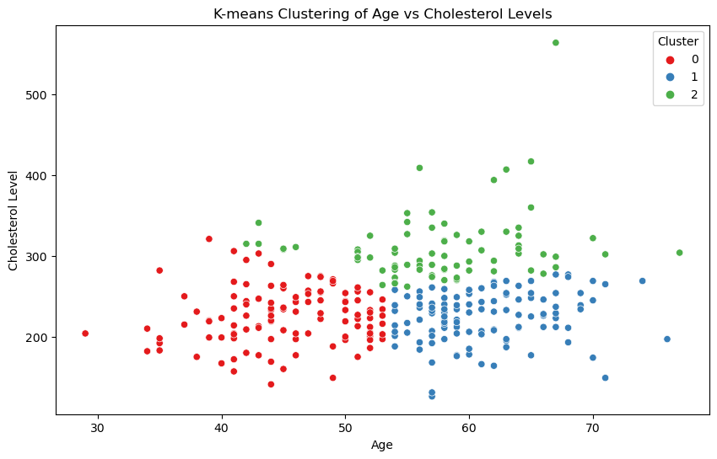
Unsupervised Analysis: K-Means Clustering + Feature Normalization
Red cluster: People in their 30s and 40s generally have lower chol level
Green cluster: People with higher chol_level are mostly in their 50s
Blue cluster: There are many in 60s with low chol level as well

Slide 8
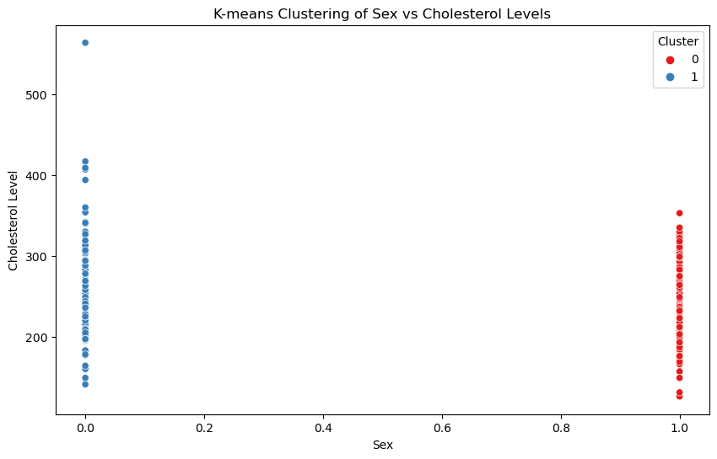
Unsupervised Analysis: K-Means Clustering + Feature Normalization
Men generally have lower cholesterol level

Slide 9
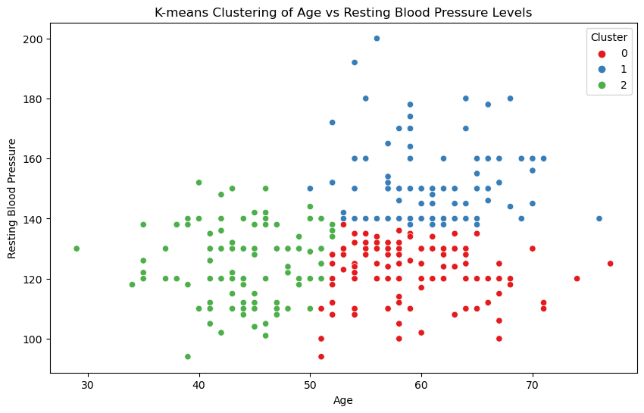
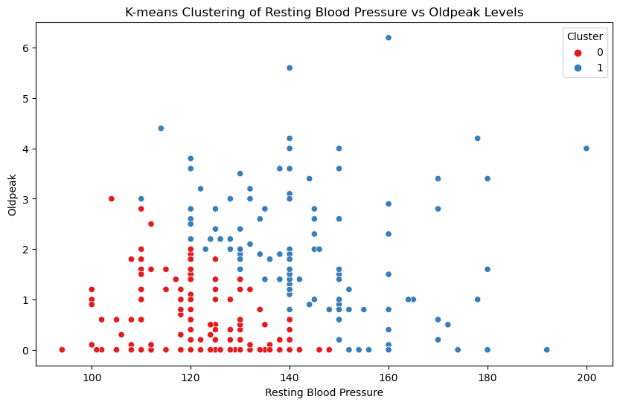
Unsupervised Analysis: K-Means Clustering + Feature Normalization

Slide 10
Data Preparation
Scaling the Data Using Standard Scaler
No encoding techniques is needed
Splitting the data in to train, validation, and test sets
Logistic Regression: 80%, 0%, 20%
SVM: 86.49%, 6.51%, 7%
Neural Network: 42%, 18%, 40%

Slide 11

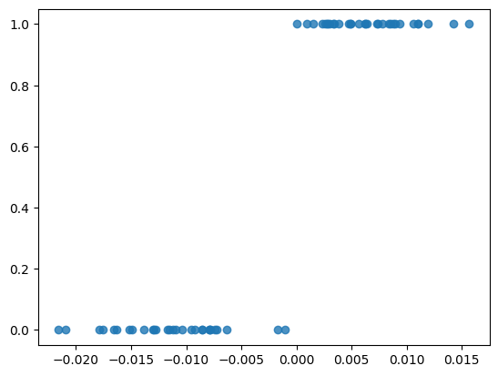
Logistic Regression: On training data
Sigmoid, log-likelihood, gradient ascent
StandardScaler
Learning rate = 1E-7
100000 iterations
Performance Metrics:
Precision: 0.875
Recall: 0.875
F1 Score: 0.875
Accuracy: 0.868852

Slide 12
Logistic Regression: Hyperparameter Tuning on Unseen Test data
Trying different learning rates and number of iterations
lr = [1e-7, 1e-6, 1e-5, 1e-4, 1e-3, 1e-2, 1e-1, 1, 5]
num_iters = [10, 30, 100, 300, 1000, 3000, 10000, 30000, 100000]
Best lambda1 = 1e-05
Best num_iter = 100000
Best accuracy = 88.52459016393442%

Slide 13
Logistic Regression: Regularization with 5-fold Cross Validation
L1 Regularization
Reg - Optimal λ: 0.3593813663804626
Reg - Accuracy on validation data = 0.852459
Reg - Accuracy on training data = 0.863636
L2 Regularization
Reg - Optimal λ: 0.3593813663804626
Reg - Accuracy on validation data = 0.852459
Reg - Accuracy on training data = 0.863636
Without regularization
No reg - Accuracy on validation data = 0.852459
No reg - Accuracy on training data = 0.863636

Slide 14
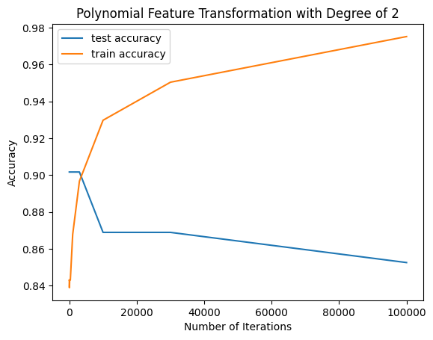
Logistic Regression: Polynomial Feature Transformation
Degree 2: 120 features
Precision: 0.8175675675675675
Recall: 0.9097744360902256
F1 Score: 0.8612099644128113
Accuracy: 0.8388429752066116

Slide 15
Logistic Regression: Polynomial Feature Transformation
Degree 2: 120 features
Precision: 0.8175675675675675
Recall: 0.9097744360902256
F1 Score: 0.8612099644128113
Accuracy: 0.8388429752066116

Slide 16
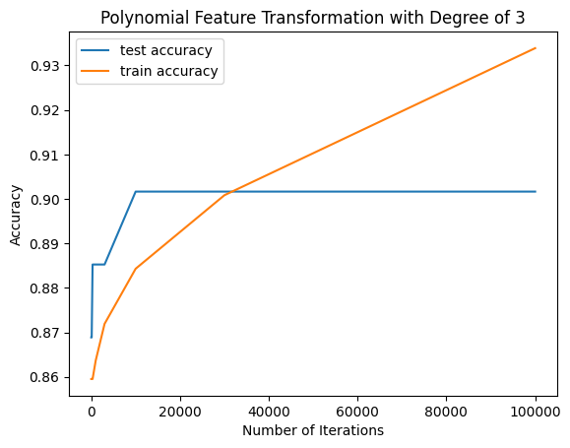
Logistic Regression: Polynomial Feature Transformation
Degree 3: 680 features
Precision: 0.9333333333333333
Recall: 0.875
F1 Score: 0.9032258064516129
Accuracy: 0.9016393442622951

Slide 17
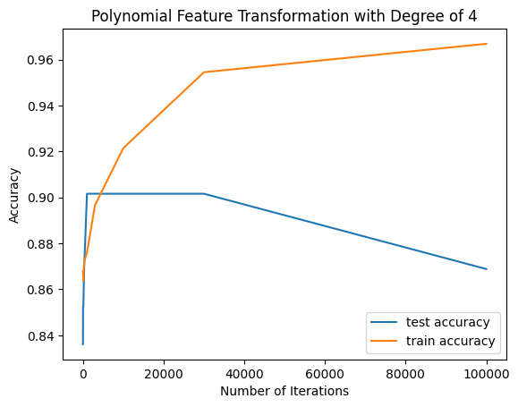
Logistic Regression: Polynomial Feature Transformation
Degree 4: 3060 features
Precision: 0.896551724137931
Recall: 0.8125
F1 Score: 0.8524590163934426
Accuracy: 0.8524590163934426

Slide 18
SVM: Data Preprocessing
We split our dataset into 93% training set and 7% testing set.
Then we further split the training set into 93% training and 7% validation set
We also scale features to ensure gradient descent converge properly

Slide 19
SVM: Feature Scaling
MinMaxScaler(feature_range=(-1, 1)) has a 55% accuracy on training set
MinMaxScaler has a 45% accuracy on training set
StandardScaler has a 75% accuracy on training set
→ StandardScaler yielded the highest accuracy on the validation set, so we use it as the scaler for our dataset.

Slide 20
SVM: Pegasos Algorithm
Using Pegasos, directly on SVM_objective function, stochastic sub-gradient descent
After hyperparameter tuning:
Best lambda1 = 0.001
Best num_iter = 10
Best accuracy = 80.0%

Slide 21
SVM: Kernel Functions
Because training our model with kernels is quite computationally expensive, we first try to use a subset of 50 data points.
Training on a subset (subset_size = 50)
Linear kernel
Polynomial kernel
RBF kernel

Slide 22
SVM: GridSearchCV
5-fold cross-validation
param_grid = {
'C': [0.1, 1, 10],
'kernel': ['linear', 'rbf', 'poly'],
'gamma': [0.1, 1, 10],
'degree': [2, 3, 4]
}

Slide 23
SVM: GridSearchCV
Mean accuracy for Linear kernel: [0.86211901 0.86211901 0.86211901 0.86211901 0.86211901 0.86211901
0.86211901 0.86211901 0.86211901 0.86204644 0.86204644 0.86204644
0.86204644 0.86204644 0.86204644 0.86204644 0.86204644 0.86204644
0.8658926 0.8658926 0.8658926 0.8658926 0.8658926 0.8658926
0.8658926 0.8658926 0.8658926 ]
Mean accuracy for RBF kernel: [0.78940493 0.55174165 0.55174165 0.78940493 0.55174165 0.55174165
0.78940493 0.55174165 0.55174165 0.82772134 0.57111756 0.55174165
0.82772134 0.57111756 0.55174165 0.82772134 0.57111756 0.55174165
0.78563135 0.58265602 0.55174165 0.78563135 0.58265602 0.55174165
0.78563135 0.58265602 0.55174165]
Mean accuracy for Polynomial kernel: [0.57467344 0.69738752 0.65130624 0.75101597 0.74738752 0.74738752
0.62082729 0.67859216 0.67859216 0.68976778 0.65522496 0.67438316
0.80087083 0.74738752 0.74738752 0.68207547 0.67859216 0.67859216
0.69738752 0.65130624 0.67438316 0.74731495 0.74738752 0.74738752
0.69782293 0.67859216 0.67859216]

Slide 24
SVM: GridSearchCV
Mean accuracy for Linear kernel: The accuracy is quite high and consistent, indicating that the linear kernel performs well on this dataset.
Mean accuracy for RBF kernel: The accuracy varies, suggesting that the RBF kernel's performance depends on the choice of hyperparameters, like gamma value.
Mean accuracy for Polynomial kernel: The accuracy also varies, indicating that the polynomial kernel's performance is influenced by the choice of hyperparameters, such as the degree of the polynomial.

Slide 25
SVM: GridSearchCV
Best Parameters: {
'C': 10,
'degree': 2,
'gamma': 0.1,
'kernel': 'linear'
}
Best Score: 0.8658925979680697

Slide 26
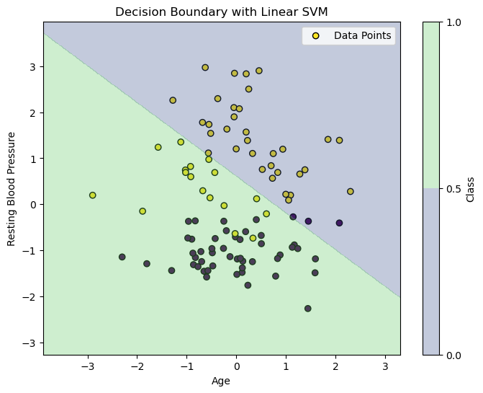
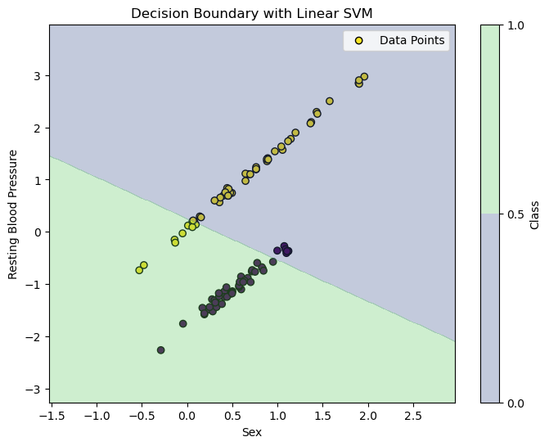
SVM: Optimal Linear Kernel

Slide 27
Neural Network: Data Preprocessing
We split our dataset into 60% training set and 40% testing set. Then we further split the training set into 70% training and 30% validation set
Standardize data using StandardScaler

Slide 28
Neural Network: Neural Network Structure
Use Pytorch
Working with Pytorch tensors instead of numpy arrays
Define our neural network model. By default:
1 8-neuron hidden layer
1 output node
Sigmoid as activation function

Slide 29
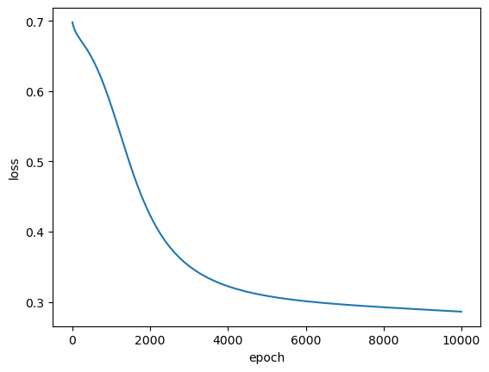
Neural Network: Training
Optimize with Stochastic Gradient Descent
Num_epoch = 10000
learning rate = 0.01
Performance metrics on training set:
Accuracy: 0.9126984126984127
Precision: 0.9076923076923077
Recall: 0.921875
F1-score: 0.9147286821705427

Slide 30
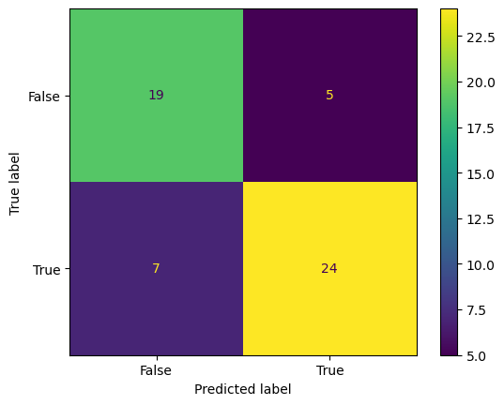
Neural Network: Validation
Performance metrics on validation set:
Accuracy 0.7818181818181819
Precision: 0.8275862068965517
Recall: 0.7741935483870968
F1-score: 0.7999999999999999

Slide 31
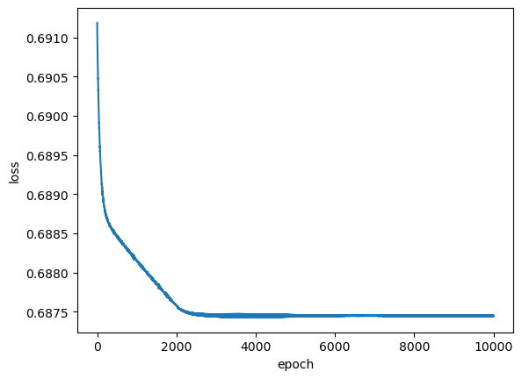
Neural Network:
L1 Regularization (default)
Default settings:
lambda = 0.01
learning rate = 0.01
Results on validation set:
Accuracy: 0.5636363636363636
Precision: 0.5636363636363636
Recal: 1.0
F1-score: 0.7209302325581396

Slide 32
Neural Network:
L1 Regularization (optimal)
Finding the best lambda values in [1e-5, 1e-4, 1e-3, 1e-2, 1e-1, 1.0]
Best lambda value for L2 regularization is 0.0001 with 98.182% accuracy on validation set
Lambda2: 1e-05, Accuracy: 0.90909
Lambda2: 0.0001, Accuracy: 0.981818
Lambda2: 0.001, Accuracy: 0.981818
Lambda2: 0.01, Accuracy: 0.872727
Lambda2: 0.1, Accuracy: 0.4363636
Lambda2: 1.0, Accuracy: 0.56363636

Slide 33
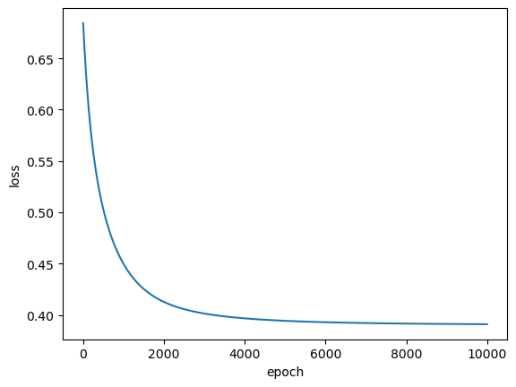
Neural Network:
L2 Regularization (default)
Default settings:
lambda = 0.01
learning rate = 0.01
Results on validation set:
Accuracy: 0.9090909090909091
Precision: 0.90625
Recal: 0.9354838709677419
F1-score: 0.9206349206349206

Slide 34
Neural Network:
L2 Regularization (optimal)
Finding the best lambda values in [1e-5, 1e-4, 1e-3, 1e-2, 1e-1, 1.0]
Best lambda value for L2 regularization is 0.0001 with 100% accuracy on validation set
Lambda2: 1e-05, Accuracy: 0.981818
Lambda2: 0.0001, Accuracy: 1.0
Lambda2: 0.001, Accuracy: 1.0
Lambda2: 0.01, Accuracy: 0.90909
Lambda2: 0.1, Accuracy: 0.563636
Lambda2: 1.0, Accuracy: 0.563636

Slide 35
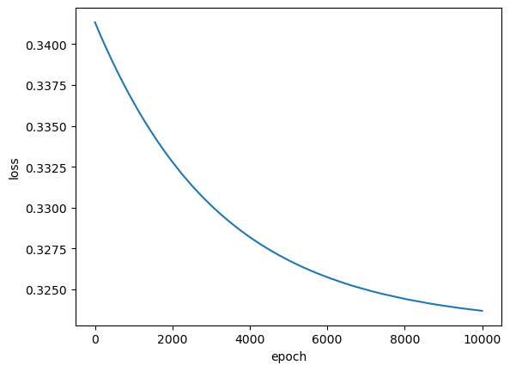
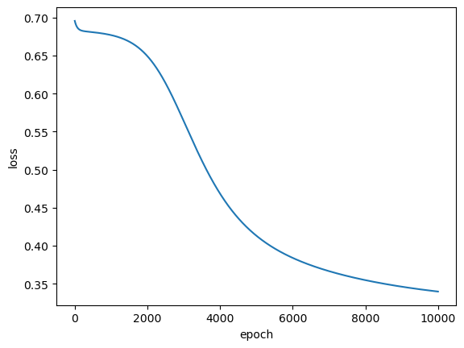
Neural Network: Regularization on Test Set
L1 regularization loss curve
L2 regularization loss curve

Slide 36
Neural Network: Regularization on Test Set
L1 regularization on test set:
Accuracy: 0.8524590163934426
Precision: 0.8611111111111112
Recall: 0.8857142857142857
F1-score: 0.8732394366197184
L2 regularization on test set:
Accuracy: 0.860655737704918
Precision: 0.8441558441558441
Recall: 0.9285714285714286
F1-score: 0.8843537414965986

Slide 37
Neural Network: Hyperparameter Tuning
param_grid = {
'n_hidden_layers': [2, 3, 4],
'learning_rate': [0.1, 0.01, 0.001, 0.0001, 0.00001],
'act_fns': ['relu', 'sigmoid', 'tanh']
}
Best parameters: {'hidden_layers': 1, 'learning_rate': 0.01, 'activation': 'relu'}
Best accuracy: 0.8363636363636363

Slide 38
Thank you for your attention

